Slide 1
EUROPEAN LANGUAGE LABEL NATIONAL REPORT - UK
Outline

Slide 2
NATIONAL CONTEXT
UK = four nations – various less widely taught languages, and separate arrangements for education
Status of English as a ‘world language’ - impact on learner motivation
FL education optional after key stage 3 (14)
Introduction of FL at primary level from key stage 1 (age 7)
lack of resources for teacher training and development
BUT due to immigration over the last 50 years, an extremely rich environment for ‘community’ languages

Slide 3
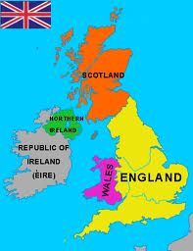

Slide 4
ORGANISATION OF THE SCHEME
Single agency – CILT/CfBT
CILT: formerly the Centre for Information on Language Teaching, then the ‘National Agency for Languages’; following funding changes, now part of a large charitable trust, CfBT (educational consultancy and quality assurance)
Contracted by the national agency for Lifelong Learning, ECORYS, itself contracted by the Department for Education
No direct involvement of government

Slide 5
PROMOTION
Website
Leaflet
e-mail shots

Slide 6
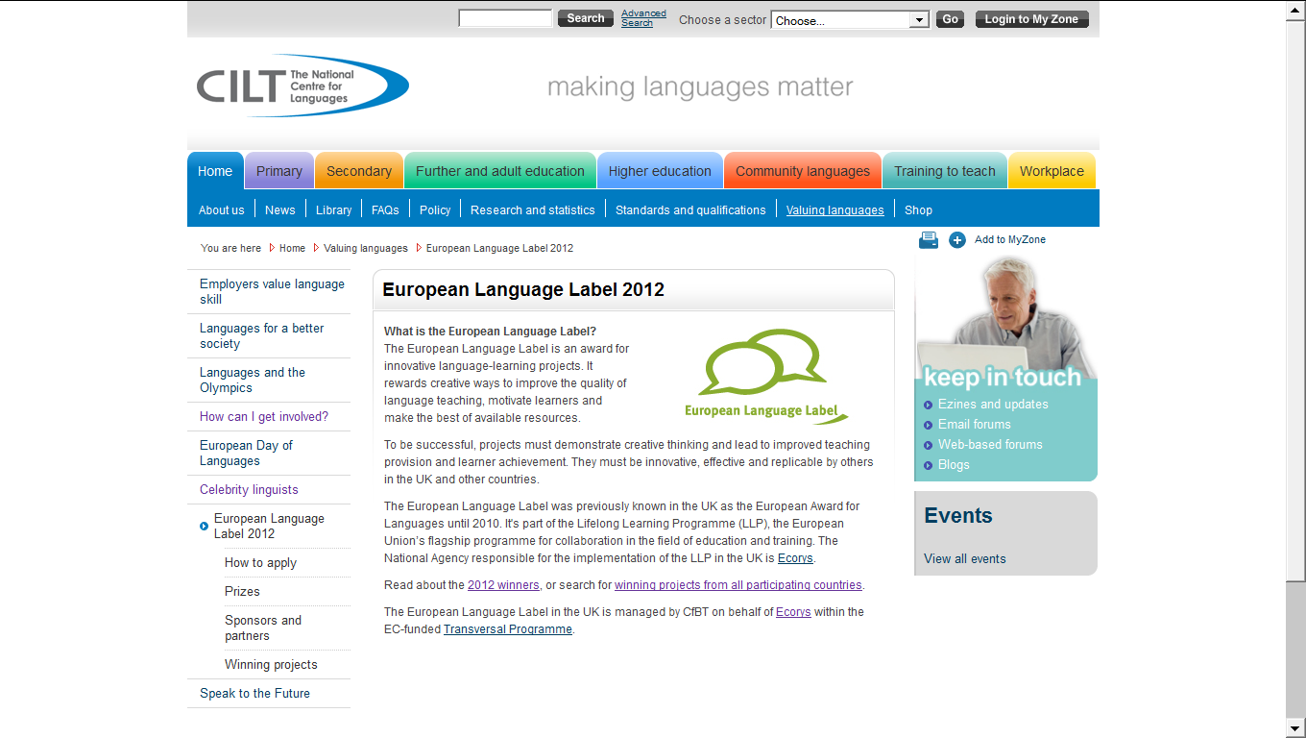

Slide 8
THE JUDGES
Unremunerated volunteers and
Representatives of sponsors (French & Spanish embassies)
All see all applications and shortlist (‘yes’, ‘no’, ‘maybe’)
All shortlisted project visited by at least one judge

Slide 9
CRITERIA
Innovative - the project should involve a new method, resource or approach and should improve on previous provision.
Effective - the project should clearly show verifiable progress towards learner targets. New projects which have not been running long enough to produce the intended outcomes will be invited to reapply in the next round of applications.
Replicable - award winning projects must have the potential to serve as a model in other contexts, languages and/or countries. Projects should also show potential for growth and development.
This year [2012] we are particularly looking for projects that involve:
Language skills as a preparation for work
Language learning in the community

Slide 10
STATISTICS

Slide 14
RECOMMENDATIONS
Intensify efforts to bring the scheme to the attention of potential applicants. Possibilities include:
Including the ELL in main menus on the CILT website
Redrafting the introductory page highlighting the international angle
Asking universities, schools which have won awards and local education bodies to include a link to the ELL page on their websites
Using social media to create links & interaction among ELL winners.
Asking key sponsors, especially the publisher to include leaflets and posters in their own mailings to schools, thus adding extra profile to their valuable annual prize.
Look for ways to maintain greater visibility for projects after the award, e.g. by creating a network of project leaders.

